Slide 1
Day 3 Morning: Constructive/Artefact Research in HCI
Prof. Shengdong Zhao

Slide 2
What is constructive/artefact research contribution?
[O&H’16] Definition: Constructive research is aimed at producing understanding about construction of an interactive artefact for some purpose in human use of computing
No known solution
partial , ineffective, or inefficient solution
Insufficient knowledge or resources for implementation or deployment
[O&H’16] Examples: Interactive systems/applications, interaction techniques, input devices, sensors, UI/Interaction/Concept/[Process] design.
[Wob’12] Definition: Artifact contributions arise from generative design-driven activities (invention). New knowledge is embedded in and manifested by artifacts and the supporting materials that describe them.
[Wob’12] Examples: new systems, architectures, tools, toolkits, techniques, sketches, mockups, environments
Notes:
What’s covered under constructive/artefact research?
We have two major frameworks, acc to. Oulasvirta and Hornbak 2016’s constructive research is aimed at producing the understanding about the construction of an interactive artefact for some purpose in human use of computing. Constructive problems have 3 subtypes: problems with no known solution, problems with partial, ineffective or inefficient solution, and problems with insufficient knowledge or resources for implementation or deployment
Example of constructive research includes interactive systems, applications, interaction techniques, input devices, sensors, UI/Interaction/Concepts/design
Wobbrick define artefact research very similar, where Artifact contributions arise from generative design-driven activities (invention). New knowledge is embedded in and manifested by artifacts and the supporting materials that describe them. Examples are new systems, architectures, tools, toolkits, techniques, sketches, mockups, environments

Slide 3
Subtypes and examples of constructive/artefact research in HCI
[O&H’16]
[No known solution] Tangible bits
[Partial solution] SenseTable
[Unable to implement or deploy] Design and deployment of a collaborative multi-surface system
[Wob’12]
[System, architecture, tools, toolkits] Boiling Mind
Evaluated holistically according to what they make possible and how they do so
[Input and interaction techniques] The bubble cursor …
Evaluated precisely and quantitatively for human performance benefits
[New design expressions] Tangible bits: towards seamless interfaces between people, bits and atoms
Evaluated by how insightful, compelling, and innovative is their portrayal
Notes:
Let’s look at more concrete examples of constructive/artefact research
[No known solution] Tangible bits, a conceptual paper that make a foundation of tangible user interface research
[Partial solution] SenseTable - a wireless object tracking platform for tangible user interfaces
[Unable to implement or deploy] Design and deployment of a collaborative multi-surface system
Boiling mind: The paper describes a wearable sensing system mapping physiological data (EDA, HR) to changes in staging elements.

Slide 4
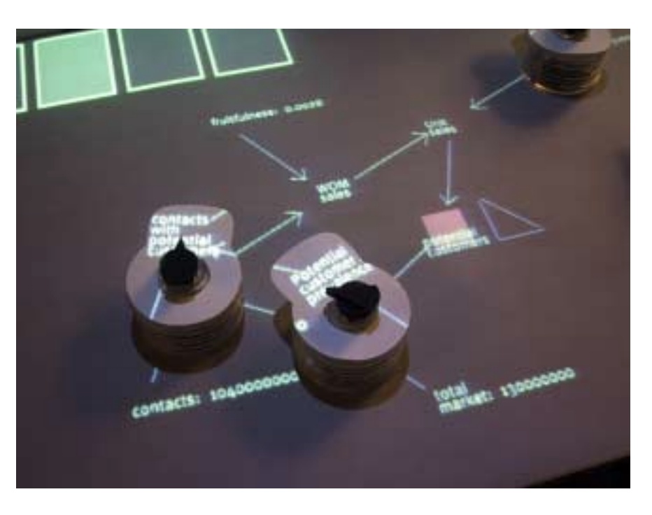
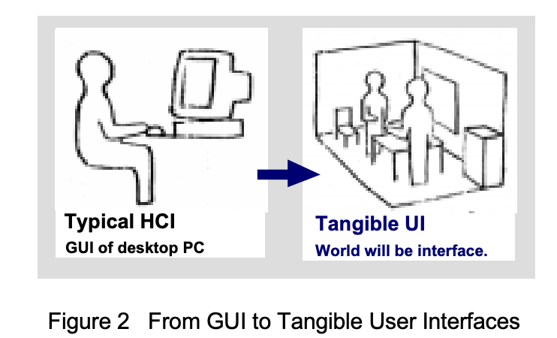
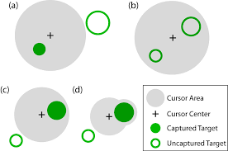
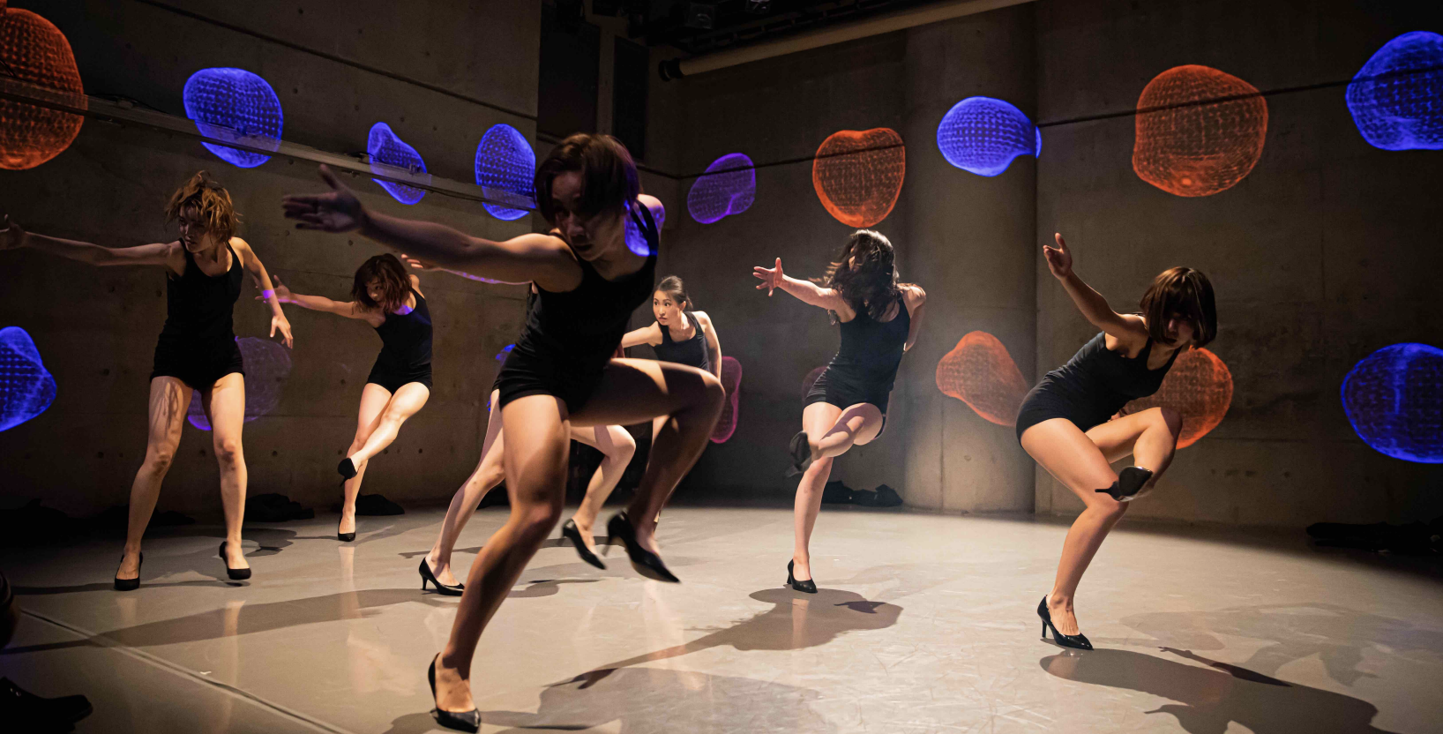
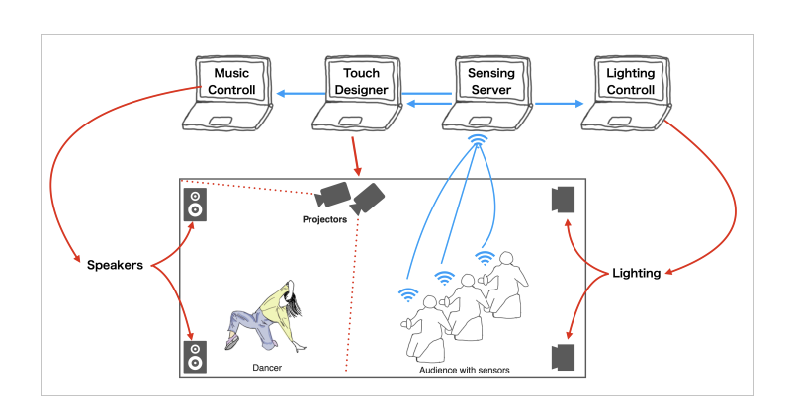
Subtypes and examples of constructive/artefact research in HCI
[O&H’16]
[No known solution] Tangible bits
[Partial solution] SenseTable
[Unable to implement or deploy] Design and deployment of a collaborative multi-surface system
[Wob’12]
[System, architecture, tools, toolkits] Boiling Mind
Evaluated holistically according to what they make possible and how they do so
[Input and interaction techniques] The bubble cursor …
Evaluated precisely and quantitatively for human performance benefits
[New design expressions] Tangible bits: towards seamless interfaces between people, bits and atoms
Evaluated by how insightful, compelling, and innovative is their portrayal
Notes:
Let’s look at more concrete examples of constructive/artefact research
[No known solution] Tangible bits, a conceptual paper that make a foundation of tangible user interface research
[Partial solution] SenseTable - a wireless object tracking platform for tangible user interfaces
[Unable to implement or deploy] Design and deployment of a collaborative multi-surface system
Boiling mind: The paper describes a wearable sensing system mapping physiological data (EDA, HR) to changes in staging elements.

Slide 5
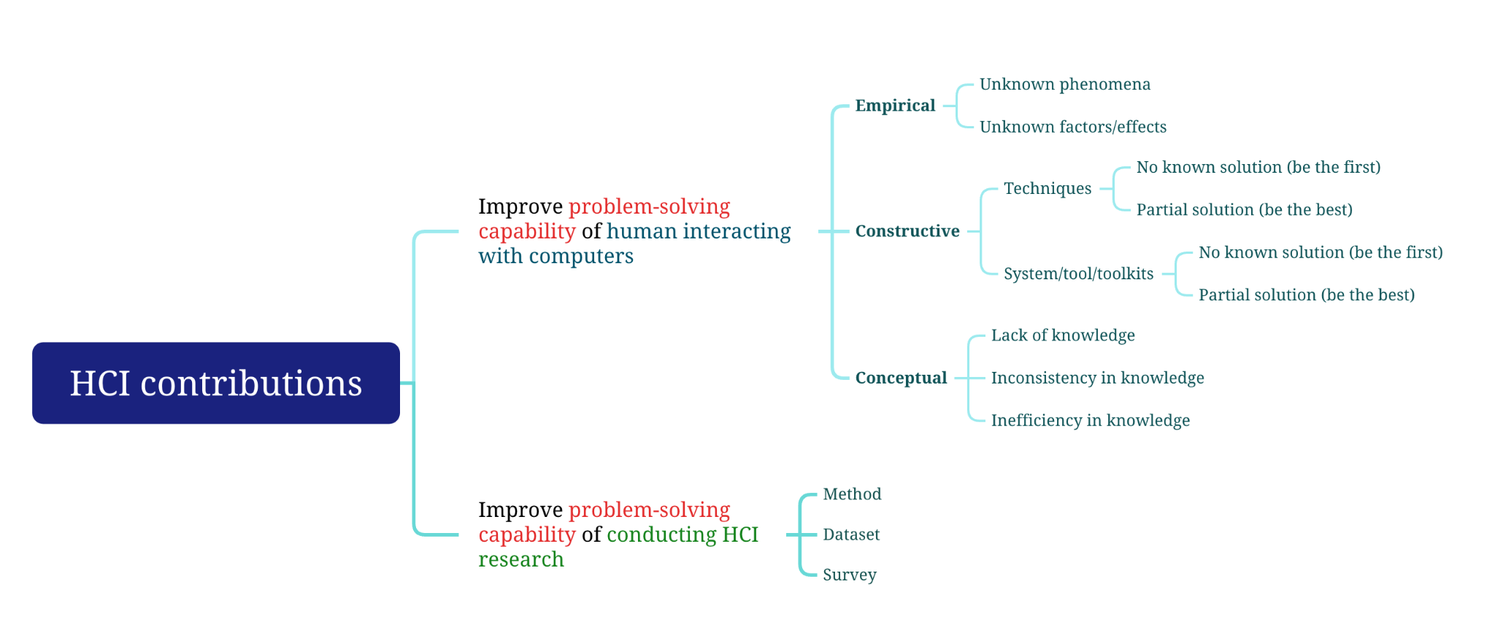
Summary of HCI contributions

Slide 6
Common Observations
Constructive/artefact research involves some kind of design elements
The common artefacts that involves some kind of constructive design include
Technique
System
Toolkit

Slide 7
Two common strategies for constructive/artefact research
Be the first
No such capabilities have been explored/developed before to solve a problem, and you are the first one to explore such new capabilities in a technique, system, or toolkit to solve that problem
Be the best
Previous techniques, systems, or toolkits exist to solve a particular problem, but your solution outperforms the previous state-of-the-art solutions

Slide 8
Interaction techniques

Slide 9

Interaction Technique
Definition: An interaction technique is the fusion of input and output, consisting of all software and hardware elements, that provides a way for the user to accomplish a generic task.
Example: Bubble Cursor (the design of a cursor that can acquire a virtual target)

Slide 10
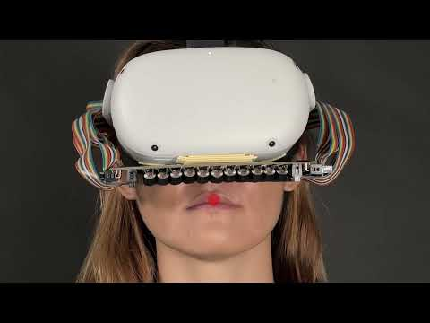
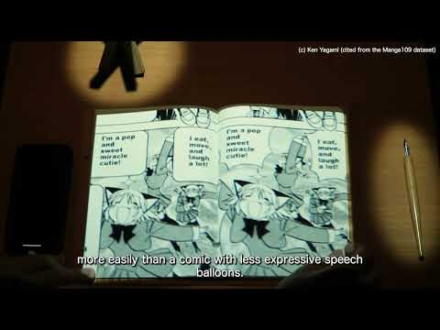
Technique examples
Be the first: Mouth Haptics
The first paper to introduce technique to achieve haptics on and inside the mouth
Be the best: EmoBalloon
The best technique to convey the strength of emotions on text chats.

Slide 11
How to conduct artefact research?
The “ideal” workflow of “an” artefact investigation
Notes:
Using XMind to show the process (so that I can show each step here)

Slide 12
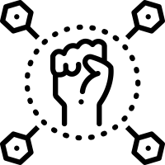
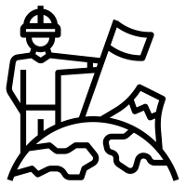



Recipe for Technique (be the first)
New capability in HCI
A design space for exploration
Some studies to understand
A showcase of usage and applications
A user study to validate the use cases
Notes:
A new (or previously unexplored) capability in HCI and its potential benefits
A design space/guideline exploration of how such capabilities can be used certain HCI tasks
Some studies to understand such capabilities in HCI context
A showcase of usage scenarios/applications with such capabilities
A user study to show the benefit of at least one of the proposed usage scenarios/applications over existing practices

Slide 13
Case study: Mouth Haptics
Mouth Haptics in VR using a Headset Ultrasound Phased Array. CHI 2022 - Best paper
A new capability in HCI and its potential benefits: Mouth haptics feedback
A new design space to explore such capabilities: VR applications that explore haptics feedback on the face
Some studies to for better understanding
A showcase of usage scenarios
A user study to show benefit of one proposed usage scenarios
Notes:
A new (or previously unexplored) capability in HCI and its potential benefits: haptics feedback on the mouth using ultrasonic transducer
A design space/guideline exploration of how such capabilities can be used certain HCI tasks: a design space of haptic feedback on the face with different types of interaction effects (like winds, heat, punching, squeezing, etc)
Some studies to understand such capabilities in HCI context (studies with 11 participants to explore the effects of haptics feedback on the tongue, lips, teeth)
A showcase of usage scenarios/applications with such capabilities (3 scenarios)
A user study to show the benefit of at least one of the proposed usage scenarios/applications over existing practices

Slide 14
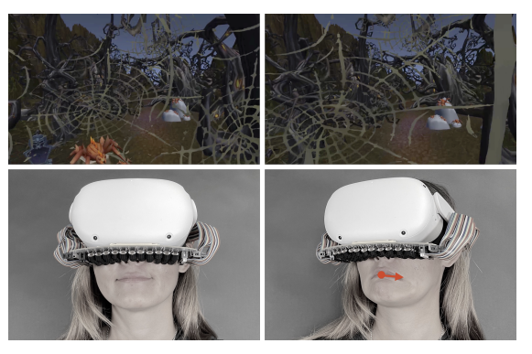
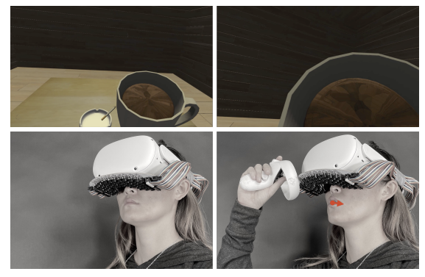
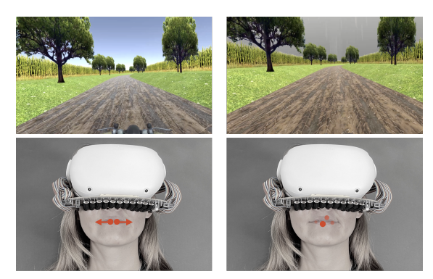
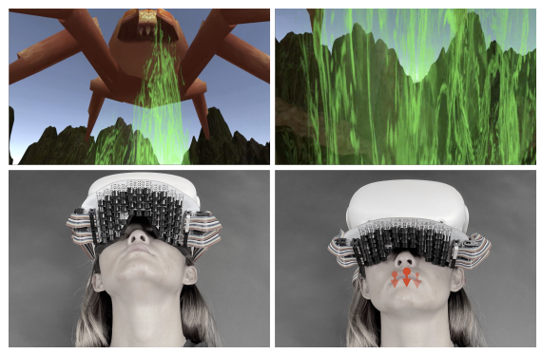
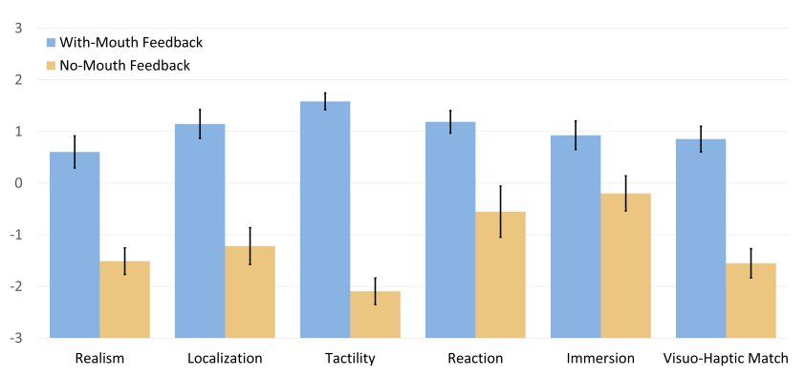
Case study: Mouth Haptics
Mouth Haptics in VR using a Headset Ultrasound Phased Array. CHI 2022 - Best paper
A new capability in HCI and its potential benefits: Mouth haptics feedback
A new design space to explore such capabilities: VR applications that explore haptics feedback on the face
Some studies to for better understanding
A showcase of usage scenarios
8 participants, 3 scenarios x 4 interactions x 2 conditions
A user study to show benefit of one proposed usage scenarios
Notes:
A new (or previously unexplored) capability in HCI and its potential benefits: haptics feedback on the mouth using ultrasonic transducer
A design space/guideline exploration of how such capabilities can be used certain HCI tasks: a design space of haptic feedback on the face with different types of interaction effects (like winds, heat, punching, squeezing, etc)
Some studies to understand such capabilities in HCI context (studies with 11 participants to explore the effects of haptics feedback on the tongue, lips, teeth)
A showcase of usage scenarios/applications with such capabilities (3 scenarios)
A user study to show the benefit of at least one of the proposed usage scenarios/applications over existing practices

Slide 15
Workflow of a “be the first” interaction technique
How can mouth haptics can be designed?
Ideation
Implementation
Run formal study
What has been done in the haptics feedback literature?
Which scenarios mouth haptics has advantages?
Literature review
Run pilot studies
Write paper
What are the design factors?
Which scenarios mouth haptics can be used?
Explore design space
Explore use cases
Notes:
Ideation: You have some idea in mind about an interaction technique that you think can enable some certain new capabilities. In this example it’s the mouth haptics feedback that has never been explored before that can actually enable new kind of interaction in virtual reality.
Literature review: To understand what has been done and what else could be done. So they survey the literature and find out that people have developed a few different kind of haptics feedback on the face like on the cheeks, forehead, on the surface of the mouth, but not inside the mouth (like teeth and tongue)
Explore design space: (what’’ew the design factors, what are the level in each design factors), come up with a rough taxonomy
Explore use cases: Brainstorm scenarios to use the new capabilities:
Pilot study: to confirm/validate the usefulness of the proposed technique. So this is to quickly prototype the ideas and test whether they are useful and promising or not. If the idea turns out do not work, and users can’t really feel any meaningful haptic feedback on the mouth then they should quickly pivot. Implementation: Implement A platform that’s capable of conduct real experiments and to demonstrate many application scenarios in which the new capability can be used. In this case study they come up with 3 scenarios: haunted forest, school simulator (where they test effect of drinking, smoking, brushing the teeth, etc), and racetrack (where they test the effect of wind, rain, puddle splash, etc.)
Conduct a formal study to validate the usefulness of the new capabilities in the previously validated scenarios. Typical studies include how human perceive and interact with such new capabilities. For example, try to understand how many different level of pressure human can perceive and can interact with. Or how many different levels of movement can a wrist perform
Write paper, create demonstration video. Show various use cases

Slide 16

https://pollev.com/szhao168
Q1
Notes:
What step do you think is the most crucial step in the success of a “be the first” technique paper?

Slide 17
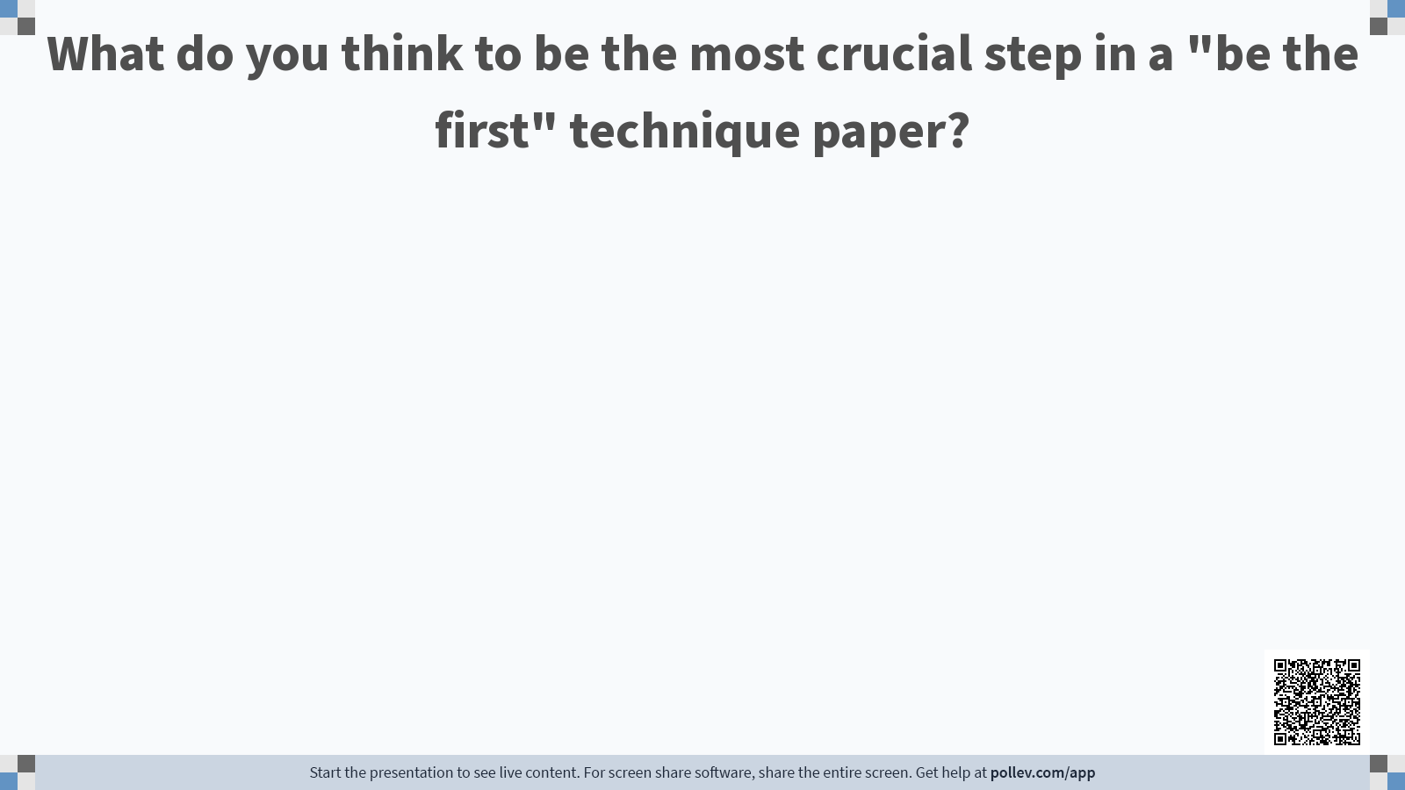

Slide 18
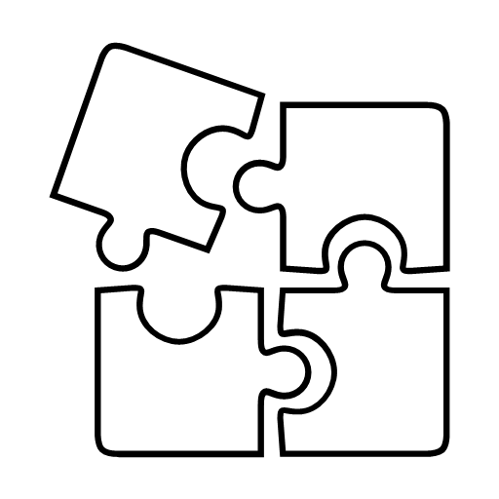



Recipe for Technique (be the best)
A well-known problem
Imperfect SOTA solutions
A novel solution
A carefully designed user study
An explanation why
Notes:
You are solving an existing (computational) problem.
There are existing computational solutions
Your solution is better than existing computational solutions in some aspects (but comparable in other aspects
A well known (narrow but important) generic task or problem in HCI
Problems/limitations of existing state-of-art solutions
A carefully designed evaluation to compare with existing state-of-the-art solutions and overcome the problems/limitations
A novel (alternative) solution design
Explain why it works better
Qualitative logical explanations
Quantitative analysis (GOMS, KLM, etc.)
Theory or model based explanations (Fitts law, cognitive theories, etc.)

Slide 19
Case study: EmoBalloon
EmoBalloon - Conveying Emotional Arousal in Text Chats with Speech Balloons. CHI 2022 - Best paper
A well known problem in HCI: text chat misses out other paralinguistic cue in face-to-face communication such as voice tone, gesture, facial expressions. Making it hard to convey emotional expression
Limitations of existing techniques: emoticon can convey emotional valence, but does not convey emotional arousal well.
A novel solution: using different shape of speech balloons to convey emotional arousal
A carefully designed user study: comparison against emoticon in terms of conveying emotional arousal
An explanation why does it work better: Using hypotheses

Slide 20
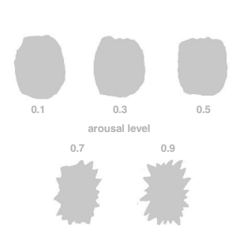
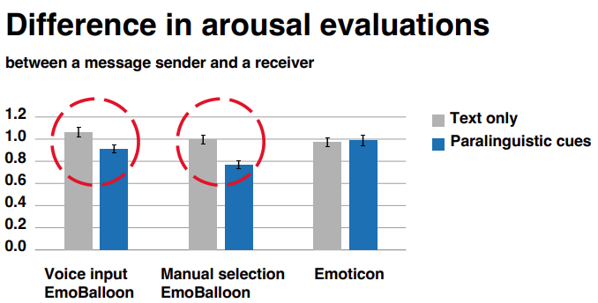
Case study: EmoBalloon
EmoBalloon - Conveying Emotional Arousal in Text Chats with Speech Balloons. CHI 2022 - Best paper
A well known problem in HCI: text chat misses out other paralinguistic cue in face-to-face communication such as voice tone, gesture, facial expressions. Making it hard to convey emotional expression
Limitations of existing techniques: emoticon can convey emotional valence, but does not convey emotional arousal well.
A novel solution: using different shape of speech balloons to convey emotional arousal
64 participants divided into 32 pairs and put into 3 groups to compare between-subjects
A carefully designed user study: comparison against emoticon in terms of conveying emotional arousal
An explanation why does it work better: Using hypotheses
Notes:
A well known (narrow but important) generic task/problem in HCI
Hierarchical menu
Problems/limitations of existing state-of-art solutions
A novel (alternative) solution design
A carefully designed evaluation to compare with existing state-of-the-art solutions and overcome the problems/limitations
Explain why it works better

Slide 21
Workflow of a “be the best” interaction technique
Crowd-source to confirm their hypothesis of text balloon conveying emotional arousal
Using ANOVA to analyse data quantitatively,
Can chat balloons be used to express emotion arousal in text chats?
Ideation
Finish formal study with bigger pool
Analyze results
How to design balloons that convey emotion arousal better?
Run pilot studies
Conduct formal study with small pool
Write paper
What are the techniques being used to express emotions in text chats?
Comparisons of sender and receiver’s perceived arousal and valence between emoticons and proposed techniques
Literature review
Design formal study
Notes:
Ideation: You have some idea in mind about an interaction technique that you think will solve a known problem. In this example, maybe the authors are reading manga and think that the chatballoon can convey emotion arousal in text like it does in manga.
Pilot studies: keep comparing with sota until you have quantitative advantages (this is the emphasis of this kind of study)
Literature review: To understand what has been done and what else could be done
Design formal study: once the proposed technique is shown to have quantitative advantages through pilot studies, formal study is designed to prove that the proposed technique is better
Conduct the study with 4-6 participants. Review and revive the study design again to make sure the study is rigorously designed and executed
Conduct the study on bigger pool of participants: in this case they study with 64 participants divided into 32 pairs and put them in 3 categories
Analyze the result. Try to give an explanation why the proposed technique is better than SOTA (link with theories for example)
Write the paper, analyze the paper’s contribution, conduct additional studies (e.g. quantitative, field experiment) to beef up the contribution. make videos and demonstration

Slide 22
https://pollev.com/szhao168
Q2
Notes:
What step do you think is the most crucial step in the success of a “be the first” technique paper?

Slide 23


Slide 24
Interactive Systems/Toolkits

Slide 25
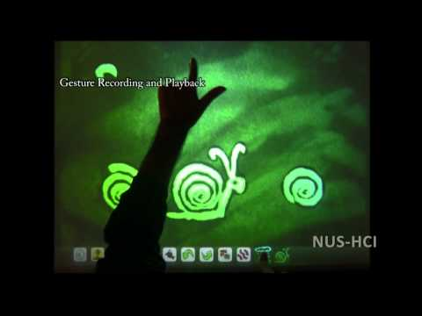
Interactive System
Definition: Interactive systems combine multiple technical components of hardware, algorithms, artificial and human intelligence, and interaction techniques to accomplish specific “complex” tasks.
Example: SandCanvas (an interactive system for sand animation)

Slide 26

Interactive Toolkit
Definition: Generative platforms encapsulate interface design concepts, including widget sets, interface builders, and development environments for designers and programmers to create new artefacts, while simplifying the authoring process and enabling creative exploration.
Example: D3 Toolkit for users to easily create data visualizations on the web.
Notes:
D3 means Data-Driven Documents. It’s a JavaScript library for producing dynamic, interactive data visualizations in web browsers. And heres a short video to introduce it.
https://en.wikipedia.org/wiki/D3.js

Slide 27
https://pollev.com/szhao168
Q3
Notes:
What step do you think is the most crucial step in the success of a “be the first” technique paper?

Slide 28
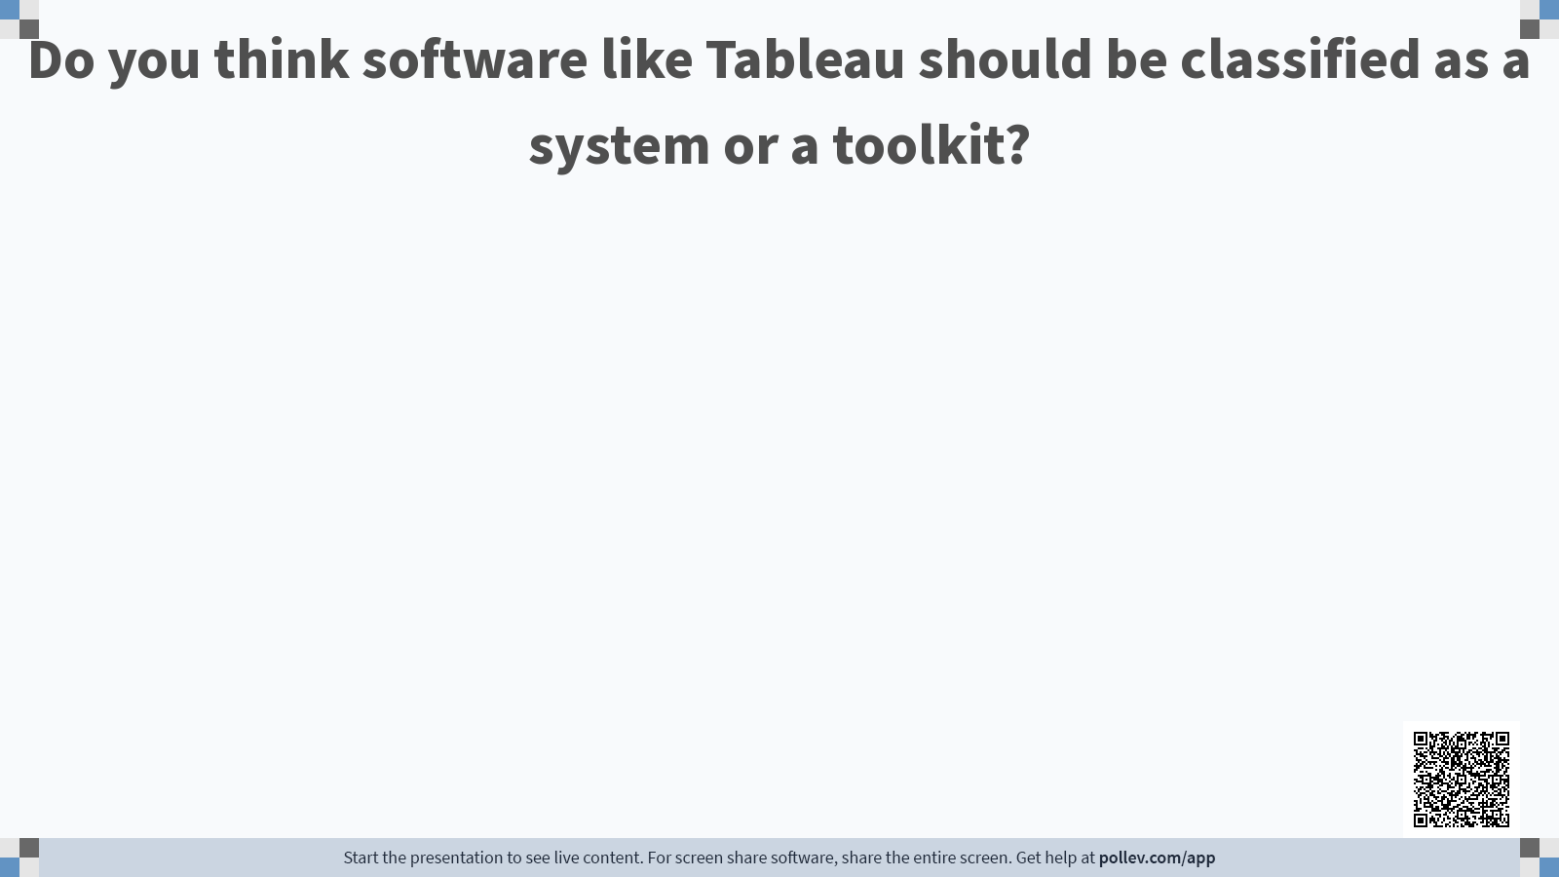

Slide 29
( Recap) Two common strategies for artefact research
Be the first
No such capabilities have been explored/developed before to solve a problem, and you are the first one to explore such new capabilities in a technique, system, or toolkit to solve that problem.
Be the best
Previous techniques, systems, or toolkits exist to solve a particular problem, but your solution outperforms the previous state-of-the-art solutions.
Notes:
We introduced other two types of artefacts, which are systems and toolkits. We also briefly discussed some relationship between these three types of artefacts. Now, we shall move to the strategies to conduct research in these two types.
General speaking, there are two common strategies. You can either be the first, or be the best.

Slide 30
Recipe for System/Toolkit (be the first)
A previously unexplored or partially explored specific computational task or generalizable authoring capabilities in certain STU (Situation, Task, User)
A design space/guideline exploration of the factors involved in such tasks/authoring capabilities
An explanation of how the system/toolkit is designed
A showcase of how the proposed system/toolkit solves the tasks or provides authoring capabilities
Evaluations to show how the proposed system/toolkit works for the proposed STU
Notes:
You are solving a new (computational) problem.
There exists a problem, but no known computational solution or computational solutions that has similar level of capabilities

Slide 31
Recipe for System/Toolkit (be the best)
A previously explored specific computational task or generalizable authoring capabilities in certain STU (Situation, Task, User)
A description of its potential drawbacks
An explanation of how the current system/toolkit is designed/implemented to overcome these drawbacks
Evaluations to show how the proposed system/toolkit did work better to overcome the previously mentioned drawbacks
With objective/subjective evaluators
With quantitative evidence

Slide 32
https://pollev.com/szhao168
Q3
Notes:
What step do you think is the most crucial step in the success of a “be the first” technique paper?

Slide 33
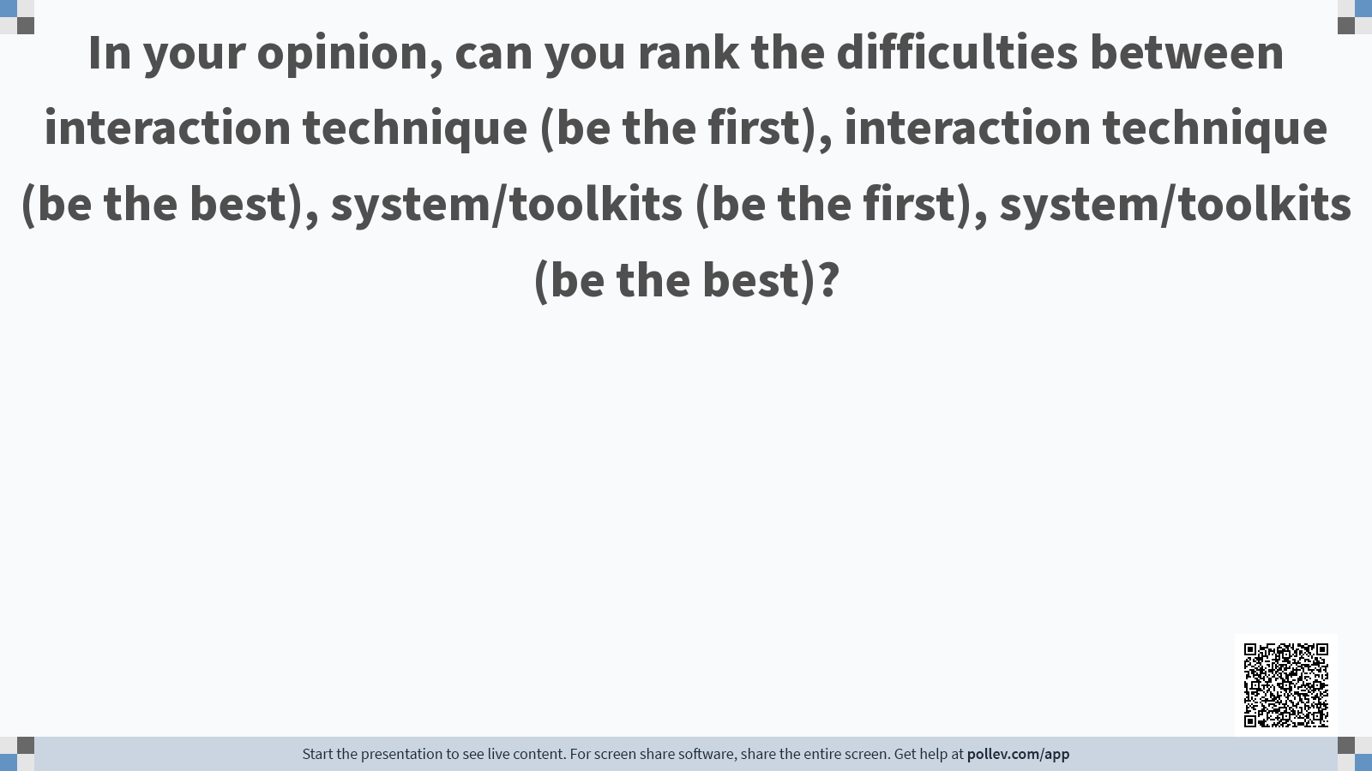

Slide 34
Level of Difficulties
System/ Toolkit (be the first)
System/ Toolkit (be the best)
Interaction technique (be the first)
Interaction technique (be the best)
<
<
<
No need to beat the state-of-the-art, but often need design space exploration, and implementation of a variety of example applications, which can take additional time.
Only need to implement one solution, and test it against the-state-of-art, but the difficulty lies in winning the comparison.
The difficulty lies in making it robust enough for stable usage and testing.
In addition to a stable implementation, need to find or implement the state-of-art system/toolkit to compare.
In both cases, toolkits are more difficult to build as compared with systems as they needs multiple evaluations on different users and scenarios.
Notes:
The difficulties for the research is also different as shown in the graph. The easiest one is interaction technique (first) as there is no baseline to compare it against with. The second easiest is interaction technique (best). However, the evaluation is very important since the end goal is to show the current technique is out perfominng the previous ones. You may want to choose different evaluators including both objective and subjective ones. The system and toolkits are getting progressively harder. First, as the system may include different hardwares and software components, it is hard to implement. Also, to demonstrate the superiority, it is necessary tofind a comparable system.

Slide 35
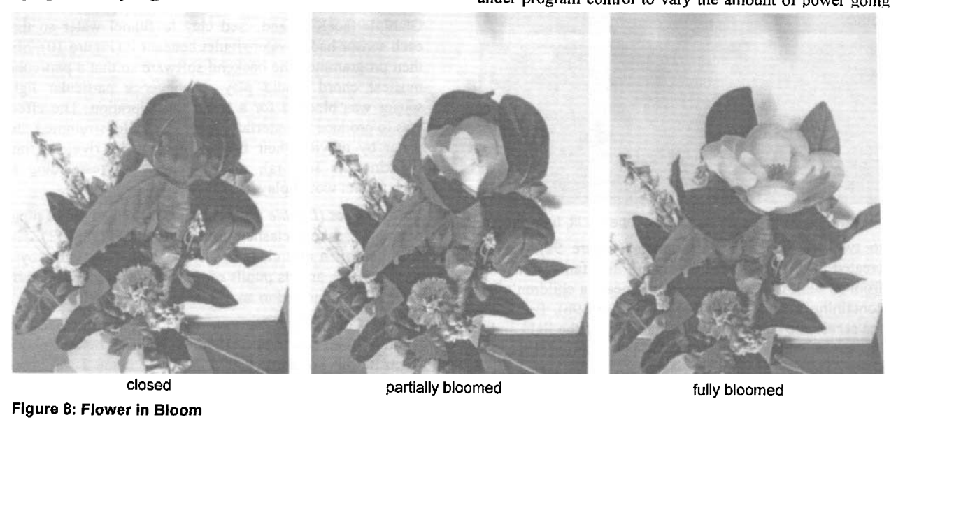
Toolkit examples
Be the First: Phidgets
The first paper to demonstrate an easy way to create physical user interfaces.
A phidget comprises a device, a software architecture for communication and connection management, a well-defined software API for device programming and many more!
It simple enough so that researchers can concentrate on the overall use, modification and recombination of devices into a physical user interface instead of low-level device construction and implementation.
Example: Flower in Bloom (Susannah McPhail) is a floral arrangement made out of artificial flowers. The central large flower can bloom under program control from a continuum ranging from closed to fully bloomed.
Notes:
Phidget is a direct analog to graphical user interface (GUI) widgets.
At that time, researchers in these areas have demonstrated many simple but exciting examples of physical user interfaces. However, there are many issues. For example, even simple devices are hard to build unless one has a background in electronics, circuit design or electrical engineering. Sadly, most computer scientists and human computer interaction specialists are not familiar with this. Commercially available devices may have no published application-programming interface (API), unless you hacked it! Thats why they envision phidget. Phidgets: easy development of physical interfaces through physical widgets.
A phidget comprises a device, a software architecture for communication and connection management, a well-defined software API for device programming, a simulation capability, and an optional onscreen component for interacting with the device.
Example: At its heart is a servo motor which controls a guideline that retracts the flower while pulling the leaves around it.
https://dl.acm.org/doi/10.1145/502348.502388

Slide 36
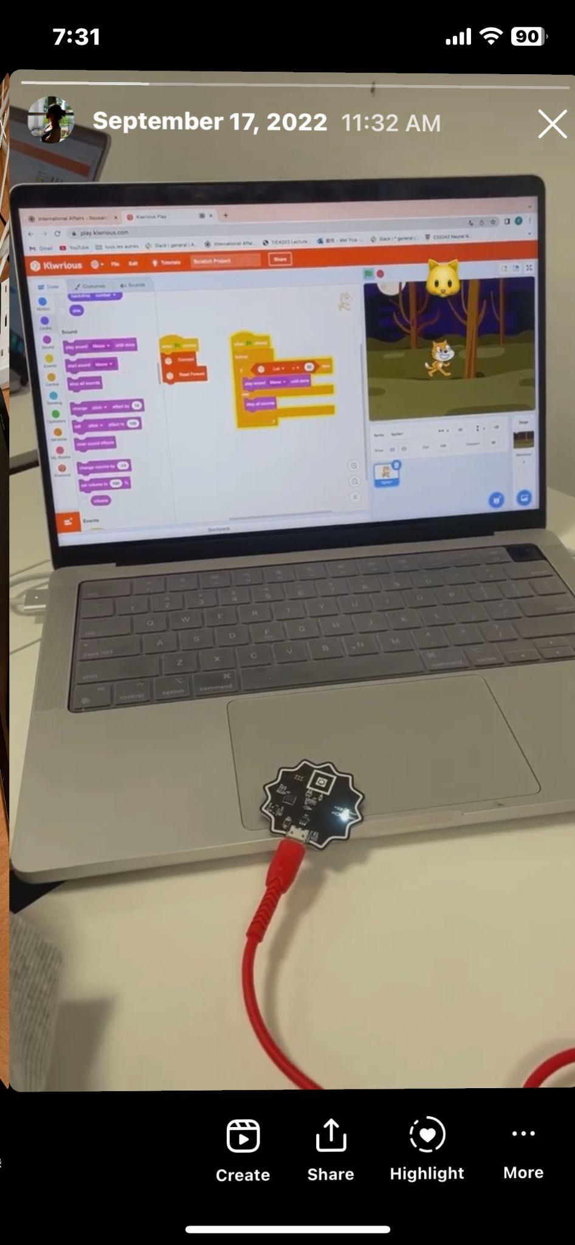
Be the First: Kiwrious
Toolkit examples
The Kiwrious is the first of its kind. It aims to empower students to engage in scientific inquiries. The Kiwrious Sensor Kit comes with 6 different sensors that help measure different scientific phenomena such as Temperature, UV Light and Heart Rate.
It also consists of the the Kiwrious Inquiry Editor and the Kiwrious Teacher Resources. The Kiwrious Inquiry Editor was designed for students to formulate scientific inquiries, make multiple observations, represent their findings in creative ways.
Notes:
This is a past project that I build. Most UV sensors designed for sunlight measurements. The cat will meow if the UV light passed a certain threshold.
https://kiwrious.com/

Slide 37
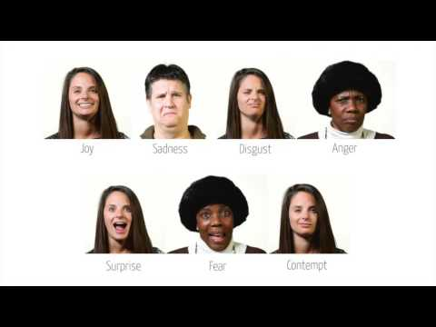
Toolkit examples
Be the best: Affdex SDK
A toolkit for designing interfaces that respond to users’ emotional states based on their facial expressions.
Trained on the world’s largest dataset of facial expressions and has been optimized to operate on mobile devices and with very few false detections.
Provides functionality for facial landmark detection, facial action classification and emotion expression modelling.
Notes:
This is a real-time facial expression recognition toolkit that can automatically code the expressions of multiple people simultaneously. The toolkit is available across major mobile and desktop platforms (Android, iOS, Windows). The system is trained on the world’s largest dataset of facial expressions and has been optimized to operate on mobile devices and with very few false detections. The toolkit offers the potential for the design of novel interfaces that respond to users’ emotional states based on their facial expressions. We present a demonstration application that provides realtime visualization of the expressions captured by the camera.
McDuff, D., Mahmoud, A., Mavadati, M., Amr, M., Turcot, J., & Kaliouby, R. E. (2016, May). AFFDEX SDK: a cross-platform real-time multi-face expression recognition toolkit. In Proceedings of the 2016 CHI conference extended abstracts on human factors in computing systems (pp. 3723-3726).

Slide 38
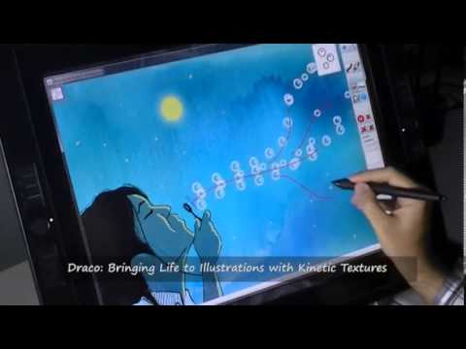
System examples
Be the first: Draco
The first paper to demonstrate an easy way to create kinesthetic texture animation.
It is a unified framework of motion controls that allows users to seamlessly add coordinated motions to object collections.
Notes:
Draco is a flexible sketch-based interface that allows users to easily augment still illustrations with dynamic effects similar to seamlessly looping video clips.
While tools for casual animation authoring using sketching and direct manipulation already existed, Draco proposes a novel animation framework they call kinetic textures,
A kinetic texture consists of a patch—a small number of representative objects that serve as a source example to generate the collection, and a set of motion properties. The motion properties define the trajectory and movement of all the objects within the collection at two different scales: the global motion and the granular motion.

Slide 39
System examples
Be the best: Boiling Mind
The paper describes a wearable sensing system mapping physiological data (EDA, HR) to changes in staging elements.
This work is done in a more comprehensive and privacy-sensitive manner compared to previous work on interactive performances.
Notes:
Connecting performers and audience via sensing technology is not new. Previously, researchers have attempted to develop various interactive system. This work is done in a more comprehensive manner compared to previous work on interactive performances.
In the pilot proof of concept performance, EEG and EOG signals were very noisy. Eyetracking and pupil dilation measurements seemed interesting, yet took relatively long to setup and calibrate to be used reliably. Among the test recordings with dancers and audiences, heart rate and electrodermal activity were the easiest to interpret as manifestations of the emotional response.
Sugawa, M., Furukawa, T., Chernyshov, G., Hynds, D., Han, J., Padovani, M., ... & Minamizawa, K. (2021, February). Boiling Mind: Amplifying the Audience-Performer Connection through Sonification and Visualization of Heart and Electrodermal Activities. In Proceedings of the Fifteenth International Conference on Tangible, Embedded, and Embodied Interaction (pp. 1-10).

Slide 40
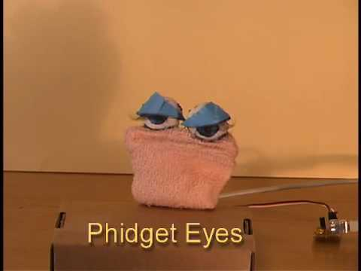
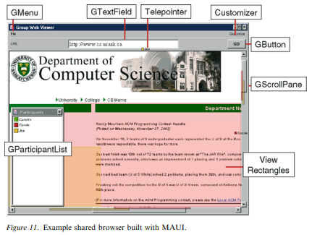
Toolkit examples
Be the first: Phidgets
The first paper to demonstrate an easy way to create physical user interfaces.
Be the best: MAUI
The best toolkit for building groupwares compared with previous state-of-the-art toolkit such as GroupKit

Slide 41
How to conduct artefact research?
The “ideal” workflow of “an” artefact investigation
Notes:
Using XMind to show the process (so that I can show each step here)

Slide 42
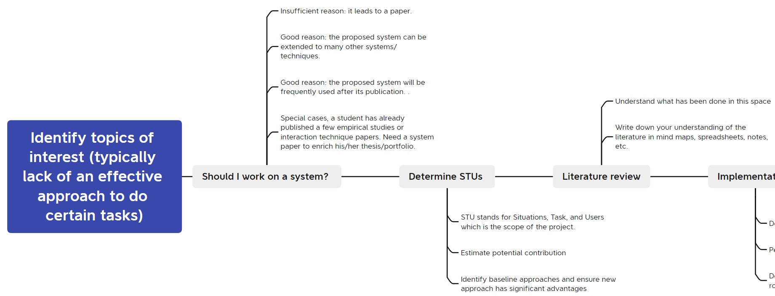
The “ideal” workflow of a system/toolkit project (first or best)
or toolkit

Slide 43
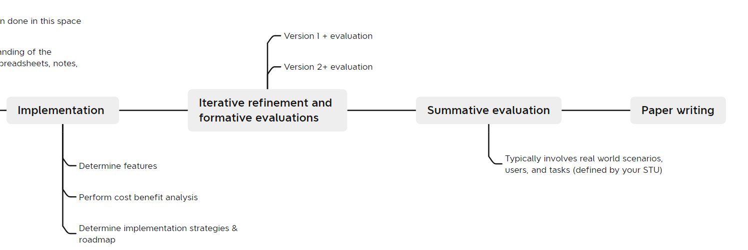
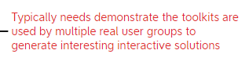
The “ideal” workflow of a system/toolkit project (first or best)
(System)
(Toolkit)

Slide 44
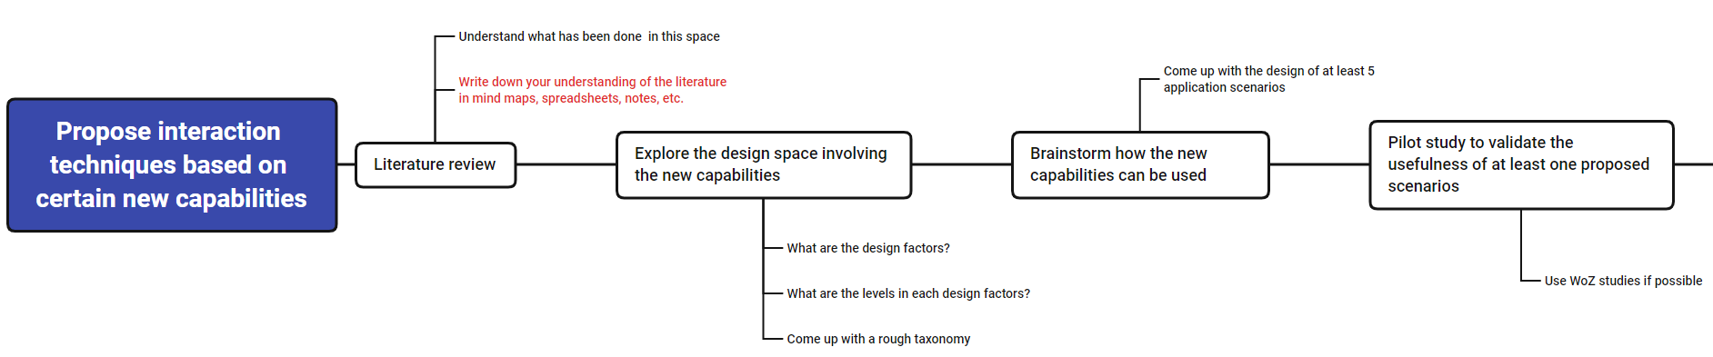
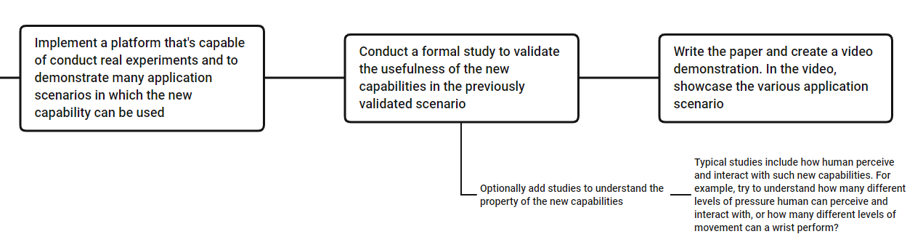
The “ideal” workflow of “an” interaction technique project (be the first)

Slide 45
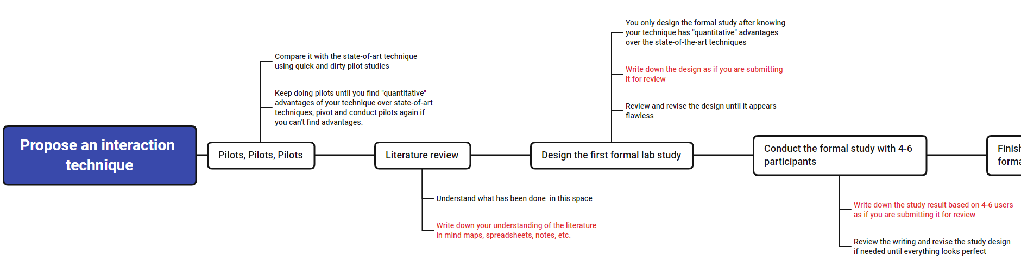
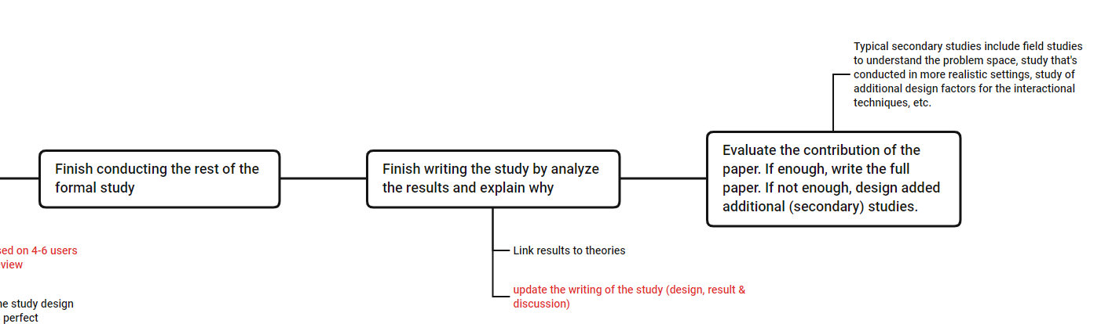
The “ideal” workflow of “an” interaction technique project (be the best)

Slide 46
https://pollev.com/szhao168
Q4
Notes:
What step do you think is the most crucial step in the success of a “be the first” technique paper?

Slide 47
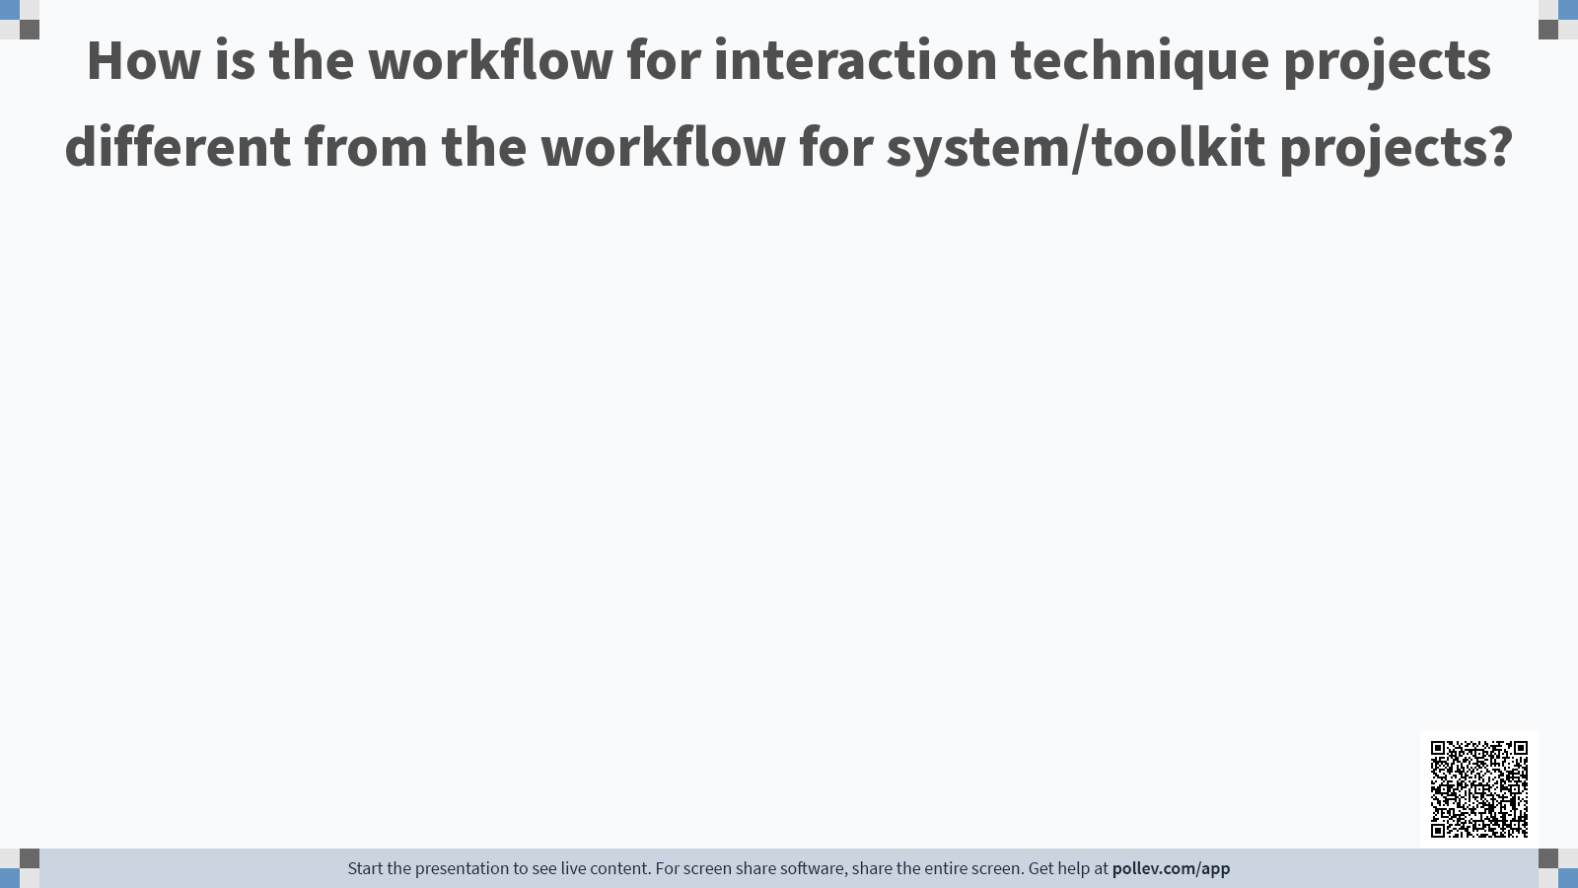

Slide 48
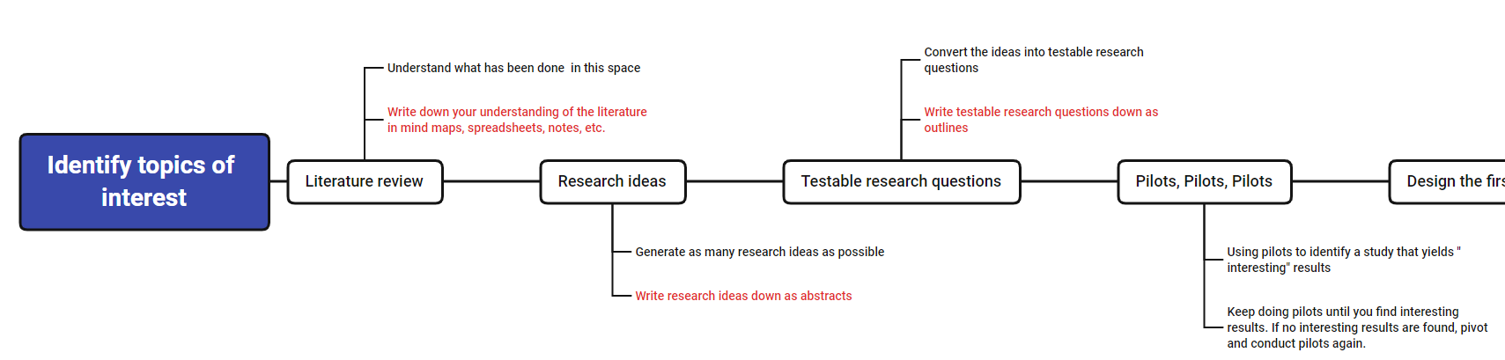
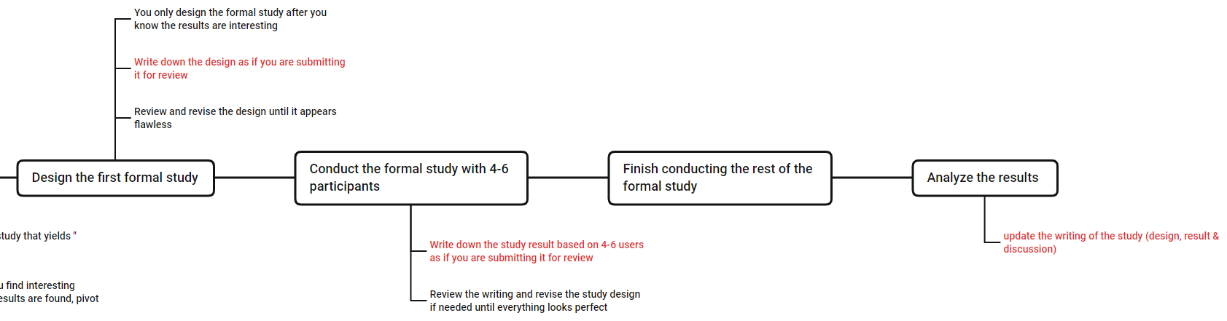
The “ideal” workflow of “an” empirical study
Stage 1: finding interesting results

Slide 49
The “ideal” workflow of “an” empirical study
Stage 2: ensure rigorous methodology

Slide 50
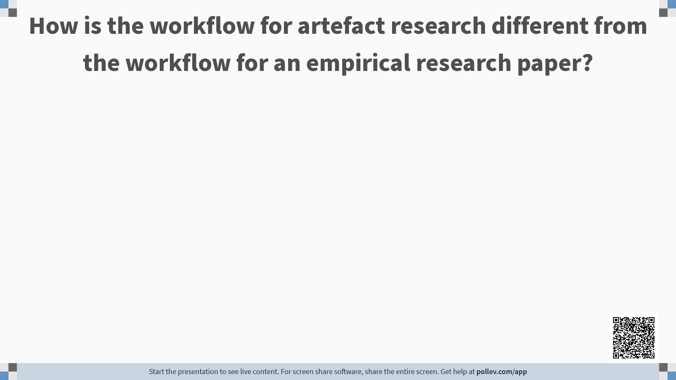

Slide 51
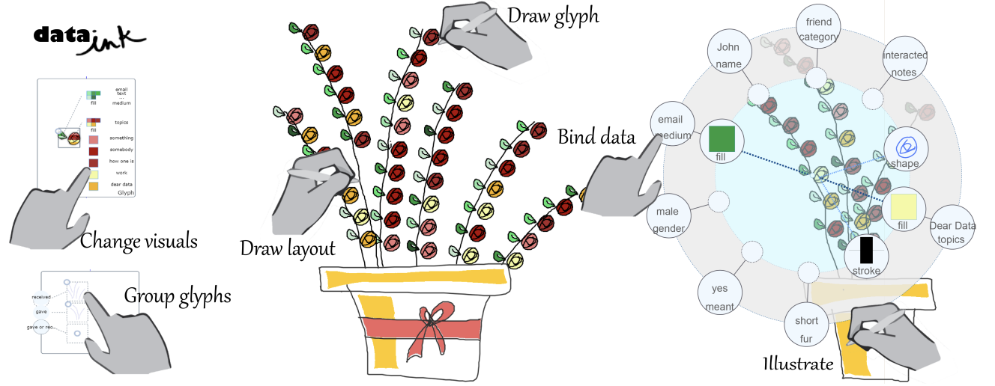
Example workflow for system/toolkit: DataInk
A system that supports the creation of expressive data visualizations with rigorous direct manipulation via direct pen and touch input.
Notes:
Xia, H., Henry Riche, N., Chevalier, F., De Araujo, B., & Wigdor, D. (2018, April). DataInk: Direct and creative data-oriented drawing. In Proceedings of the 2018 CHI Conference on Human Factors in Computing Systems (pp. 1-13).

Slide 52
DataInk addresses the lack of visualization software that supports design creativity
Existing toolkits (e.g., D3, ggplot2) typically require users to have programming knowledge and good command of the toolkit’s functionality. At the same time, they lack the necessary functionality for graphic design.
Research question – can we create a system that allows users to craft highly customized and stylized visuals by sketching, while still ensuring that ensure that their visual properties comply with the data being encoded?

Slide 53
Situation, Task and Users: Graphic designers and non-experts design data visualizations
Potential contributions:
New visualization toolkit that might be frequently used after release
Contribute to the literature on systems that allow users to specify the dynamic and interactive behavior of graphics through sketching (e.g., Draco)

Slide 54
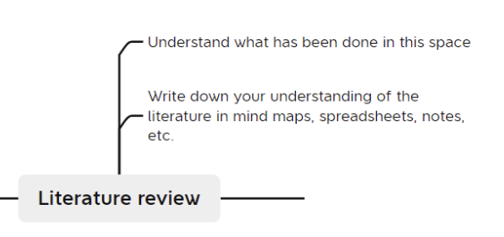
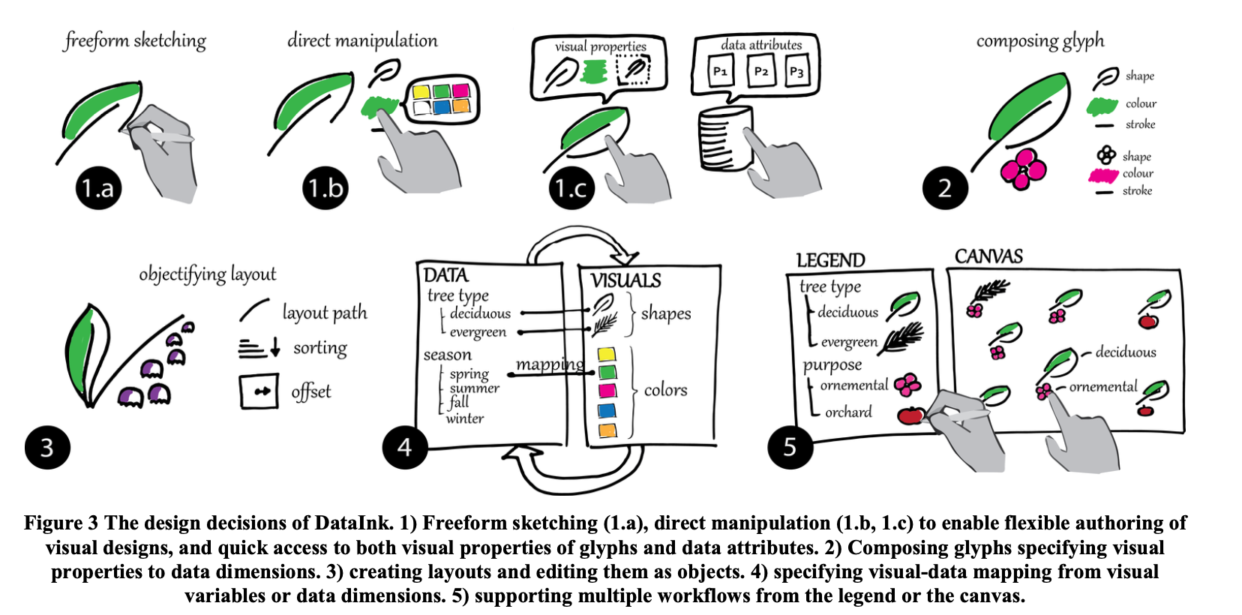
Notes:
Lit review to understand the existing space of authoring tools for data visualization
Covering major visualization tools like Excel, ggplot, D3, Tableau
Implementation: Articulated a set of five design decisions grounded in previous work.
Create and manipulate with direct input
Data points as glyphs
Layout as object
Bidirectional mapping between data dimensions and visual properties
Flexible workflows

Slide 55
(System)
(Toolkit)
DataInk authors performed usage and demo evaluations
Short training session to introduce participants to the DataInk interface
Participants to replicate a data visualization for a new dataset without guidance.
Participants to design their own data visualizations
After the tasks, participants completed a feedback questionnaire and an interview to understand factors such as the learning curve, expressive power, space for creative exploration and suggestions for improvement
Notes:
Unlike Boiling Mind, where the iterative refinement process was described clearly, the DataInk paper only describes the final product.
Testing was performed with both professional designers, to understand how DataInk performs compared to graphics design tools, and non-experts with limited experience in programming, data analysis and design to understand receptiveness by a general audience.
Compare this to Draco (system), where participants either had good sketching/illustration skills or were professional animators, and Boiling Mind, which was just tested in a performance scenario.

Slide 56
Example workflow for system/toolkit - WizardAR Tool
or toolkit
Survey literature
Lack of pilot testing tools for Heads-up computing
Once developed, it can be frequently used
Designer/researchers conduct pilot studies for AR innovation or research

Slide 57
Example workflow for system/toolkit - WizardAR Tool
(System)
Two iterations before the final design
(Toolkit)
Summative evaluation
Implement based on a roadmap

Slide 58
Summary
Roughly 4 types of constructive/artefact papers
Technique (be the first)
Technique (be the best)
System/toolkit (be the first)
System/toolkit (be the best)
Technique is easier than system/toolkits (try that first as beginner)
Be the first often uses design space mapping/taxonomy (learn how to do this)
Don’t just randomly design, but design systematically
Plan your implementation wisely/efficiently
Prioritize your implementation based on the contribution size and effort
Artefact research often includes empirical research
Master empirical research

Slide 59
Additional Notes

Slide 60
Presentation Tips for Artefact Papers

Slide 61
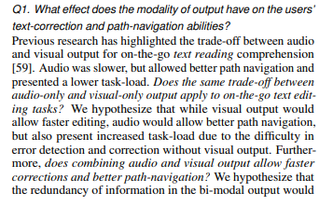
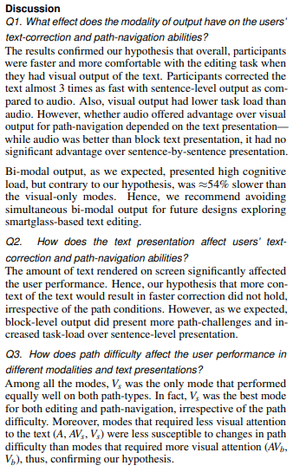
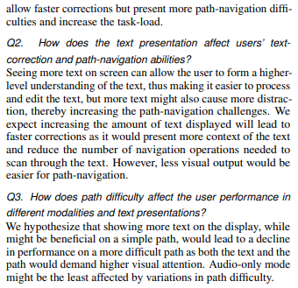
Q & A style storytelling
Before the study,
raise the question
After the study,
answer the question

Slide 62
Be aware of the need of video demonstration
For artefact/constructive contributions, a video is almost required
Think of what you want to show to reviewers/readers early
Always record your design process as well as the evaluation in photos and videos
They can be very useful and convincing evidences in your video

Slide 63
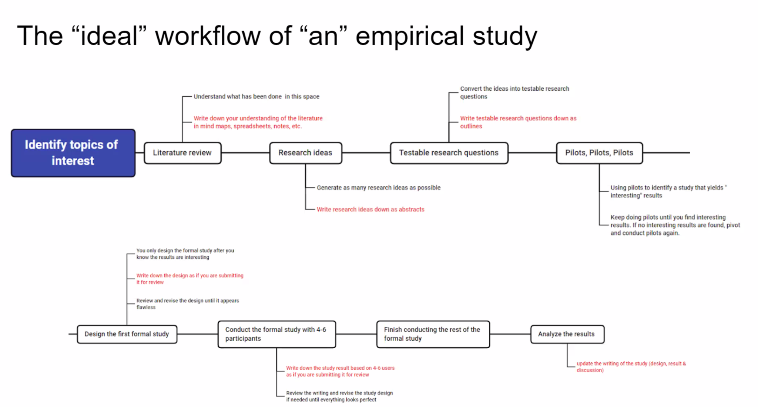
Notes:
Comparing with the previous slide

Slide 64
Design space mapping & Taxonomy
Design space is the space in which possible solutions can be derived for a given problem. It is typically very large and complex.
Design space mapping or taxonomy helps users to understand and better navigate within the space by organizing the space into smaller spaces using certain dimensions with properties (categorical or spectrum variables).
This is often needed in be the first type of projects
To tell people why you are the first
To help people to understand and navigate the design space you have explored
To frame the reader’s mind into your scope and reasoning

Slide 65
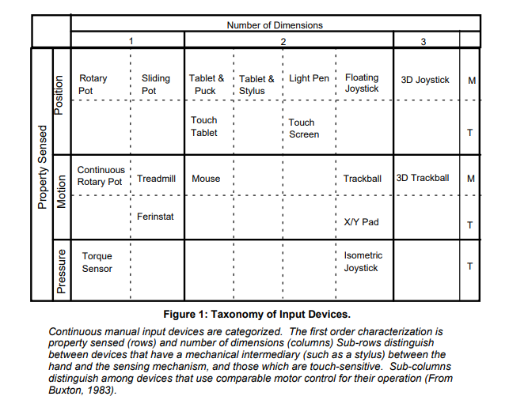
Examples of design space mapping

Slide 66
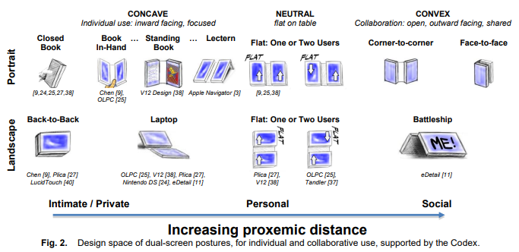
Example 2 Design Space of Dual-screen Postures
Notes:
https://dl-acm-org.libproxy1.nus.edu.sg/doi/pdf/10.1145/1518701.1518996

Slide 67
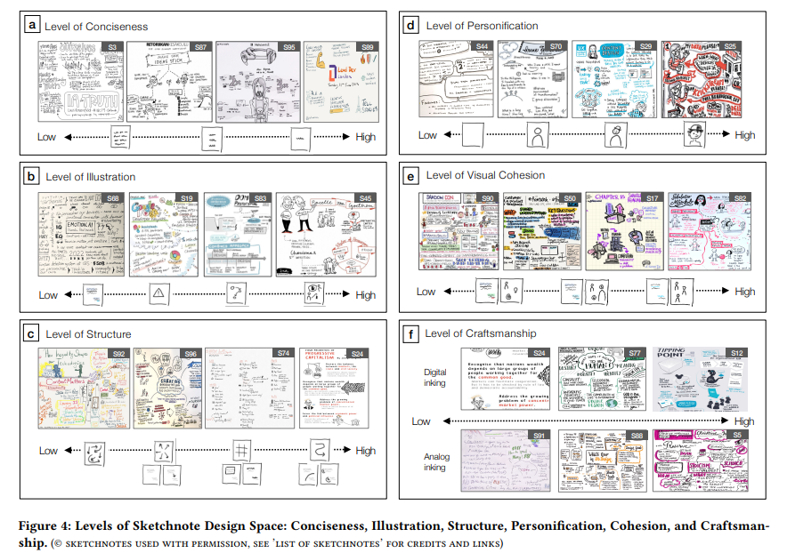
Example 3 Design Space of Sketchnotes
Notes:
https://dl-acm-org.libproxy1.nus.edu.sg/doi/pdf/10.1145/3411764.3445508

Slide 68
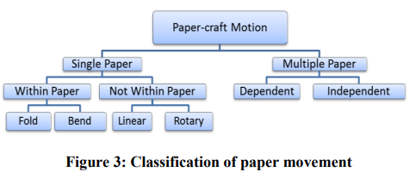

Example 4: Design Space of Paper-craft Animations
Notes:
https://dl-acm-org.libproxy1.nus.edu.sg/doi/pdf/10.1145/2470654.2470748

Slide 69
Steps to come up with design space mappings
Brainstorming and list down all possible dimensions and their levels
Pick the top “X” (typically less than 4) dimensions to create a map/taxonomy
Revise and iterate
Notes:
https://dl-acm-org.libproxy1.nus.edu.sg/doi/pdf/10.1145/2470654.2470748

Slide 70
Additional Consideration for System/Toolkit Papers

Slide 71
Be careful of starting a system/toolkit project
System papers take longer to complete
Typically one year or longer
System papers are harder to get accepted
It contains too many features/components, thus more difficult to argue for its novelty, and explain the exactly reason behind its advantages.
Start a system project only if (paste figure)

Slide 72
Plan Implementation Roadmap
List down the features
Determine priority based on cost/effect ratio
Cost: time, energy, money, etc.
Effect: dependency, contribution
What’s a minimum viable prototype?
Start small, gradually increase system complexity
What’s a minimum viable paper?
Effective use of time before deadlines

Slide 73
Evaluation a system/toolkit
Usage
Used by 35/68 toolkit papers, often combined with demonstration (33/68) or technical evaluation (9/68)
Show paths of least resistance for authoring/creation
How (different) users might work with it
Is it conceptually clear?
Easy to use?
Valuable to the audience?
Ways to conduct usage studies (Likert scale & open ended questions)
Stronger methods
A/B Comparisons
With another tool (MAUI [ref] vs. GroupKit [ref] vs. Java) [most difficult]
With different versions of itself (Paperbox [ref], XDStudio [ref]) [easier]
Take-home studies (Phidgets [ref], jQMultiTouch [ref], Proximity Toolkit [ref]) [difficult]
Ok methods
Usability studies (Papier-Mache [ref]), d.tools [ref])
Identify issues, measure participants’ performance (time, accuracy, etc.), qualitative feedback
Weaker methods
Observations (HapticTouch [ref])
Walkthrough demonstrations (RetroFab [ref])

Slide 74
Evaluation a system/toolkit
Demonstration
Used by 66/68 toolkit papers (19/68 used only demonstration, 47/68 used it in combination with other methods)
Show paths of least resistance for authoring/creation
What the toolkit might support
Exploration of threshold, ceiling, or design space
Examples
Novel applications
Replicate examples
Ideally, the examples come from a design space
WatchConnect [ref], Proximity Toolkit [ref], Pineal [ref]
Show step-by-step instructions on how examples are created using the toolkit

Slide 75
Evaluation a system/toolkit
Technical performance
Used by 18/68 toolkit papers, often combined with demonstration or usage
Benchmark, quantify or analyze toolkit to verify its performance.
Measured by
Efficiency
Precision
Or in comparison with prior techniques
Ways to evaluate technical performance
Benchmarking against thresholds
For example, 30 fps for real time tracking systems
Benchmarking against state-of-the-art
CapSense compare with CapToolkit for capacitive sensing performance
D3 compare with Adobe Flash for page load time

Slide 76
Summary of System/Toolkit Evaluation Tips
System/toolkit evaluations are hard, one need to justify many features and show their relative pros and cons. It is difficult to do in one study.
If space allows, use iterative refinement
Perform multiple formative evaluations on different versions of the system/toolkit
Explain implement of different aspects in each iteration
Plus a summative evaluation in the end
A comparison study is always preferred. However, it is difficult to compare with other people’s solution (code not available, not customizable, or too difficult to customize)
One can create multiple versions of the solutions and compare each other
Sometimes it is difficult to get valuable feedback when evaluate with ordinary users. If possible, the feedback from a few expert users are much more valuable than many ordinary users.
Toolkit evaluation needs multiple users groups and scenarios, thus is difficult to carry out
One can take advantage of design workshops or courses

Slide 77
End

